Slide 1
ISI - Integração de Sistemas de Informação
Parte 3 (v)
ETL with Pentaho Kettle
Instituto Politécnico do Cávado do Ave
Escola Superior de Tecnologia
ESI

Slide 2
ISI
  ETL com Kettle (PDI: Pentaho Data Integration)
  ETL is the acronym for Extraction, Transformation, and Loading, which is used to describe the data-processing layer in a data - integration or data warehouse solution⁽¹⁾.
    Problem
    Design
    Solution

Slide 3
ISI
Pentaho Kettle Installation
  Download JAVA
    https://java.com/pt_BR/download/windows-64bit.jsp
    https://www.java.com/en/download/manual.jsp
    Controlar JAVA_HOME
  Download Pentaho Data Integration - Kettle
    https://community.hitachivantara.com/s/article/data-integration-kettle
    https://help.pentaho.com/Documentation/6.1/0F0/0L0/030/010
    https://wiki.pentaho.com/display/EAI/Latest+Pentaho+Data+Integration+%28aka+Kettle%29+Documentation
Pentaho Community Edition (CE) Installation Guide for Microsoft Windows
https://www.hitachivantara.com/en-us/pdfd/white-paper/pentaho-community-edition-installation-guide-for-windows-whitepaper.pdf

Slide 4
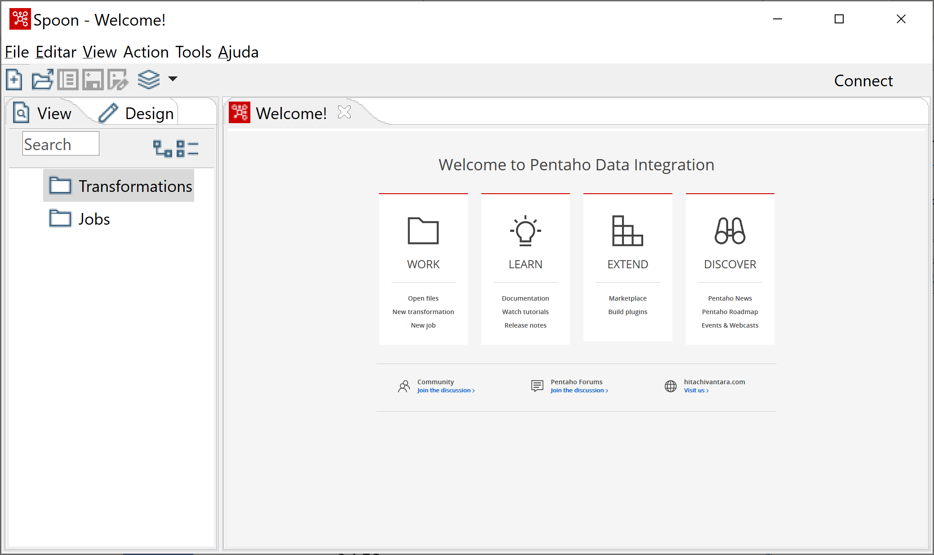
ISI
ETL with Kettle
~/data-integration/Spoon.bat

Slide 5
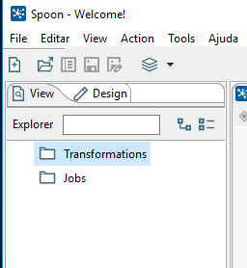
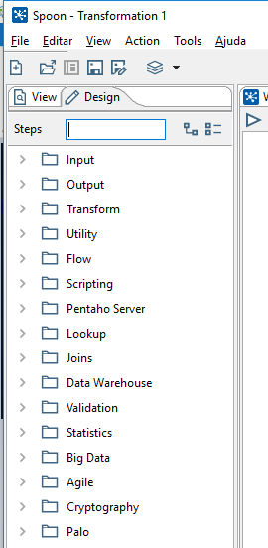
ISI
ETL with Kettle
  Jobs
  Transformations
    Steps
      Input
      Output
      Transform
      Join
      Filtering
      Flow
      Etc….

Slide 6
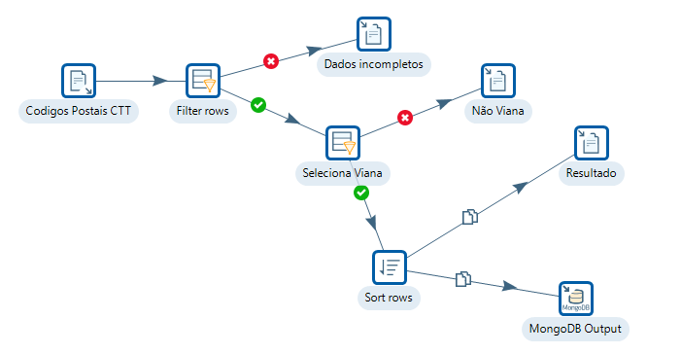
ISI
ETL with Kettle
  Jobs (*.kjb)
  Transformations (*.ktr)

Slide 7
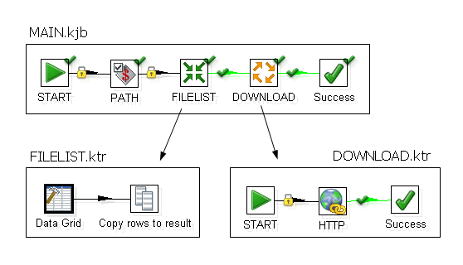
ISI
ETL with Kettle
  Jobs (*.kjb)
  Transformations (*.ktr)

Slide 8
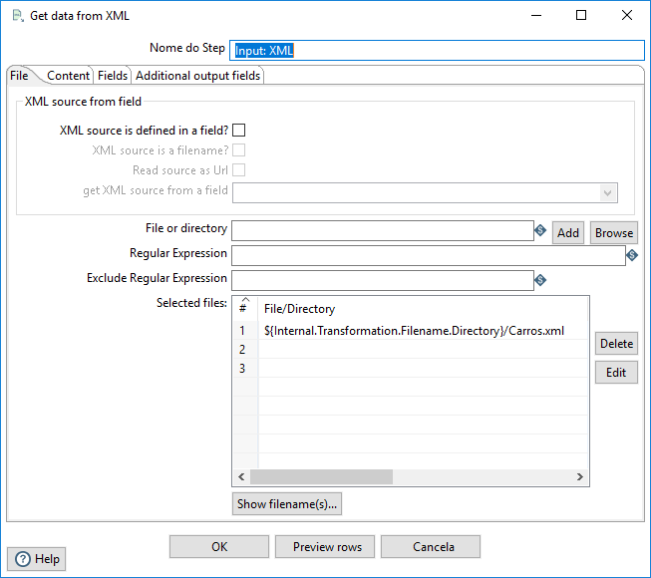
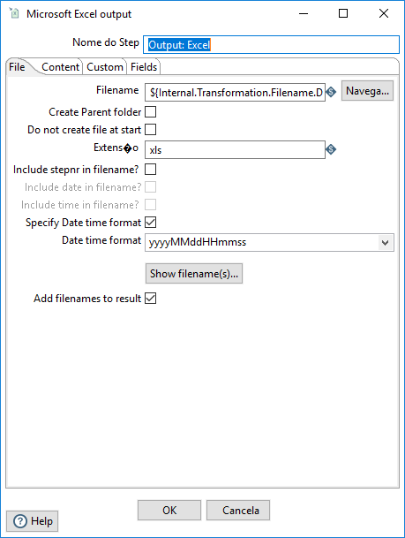
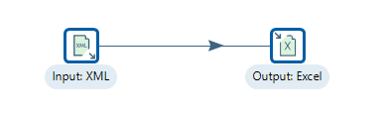
ISI
ETL with Kettle
    Caso de Estudo (I):
    Importar XML → Exportar CSV

Slide 9
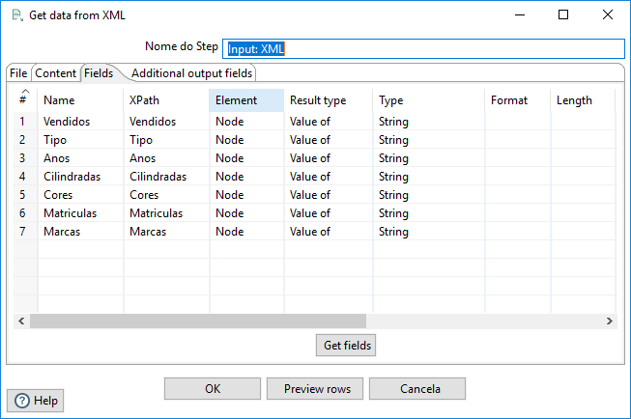
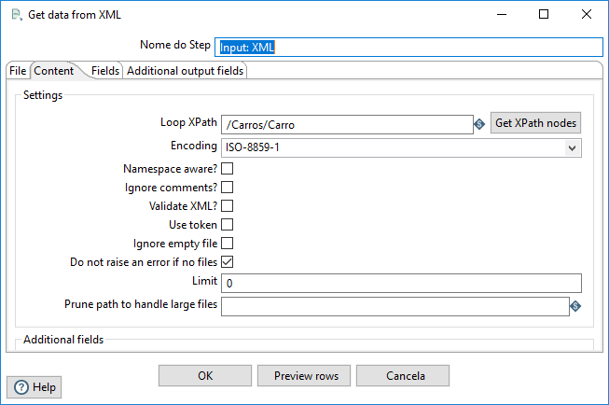
ISI
ETL with Kettle
    Caso de Estudo (I):
    Importar XML → Exportar CSV
Fields
Contens

Slide 10
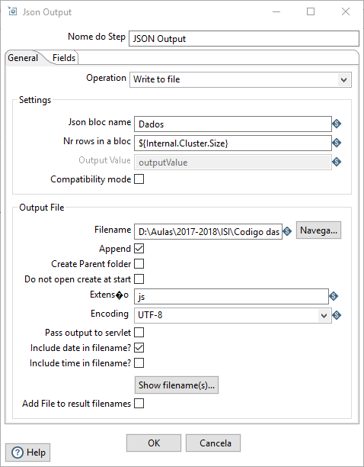
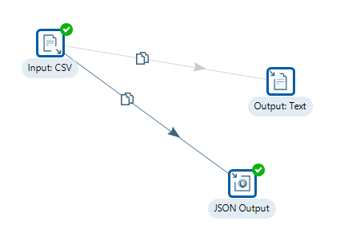
ISI
ETL with Kettle
    Caso de Estudo (I):
    Importar XML → Exportar CSV
Ver: https://wiki.pentaho.com/display/EAI/JSON+output

Slide 11

ISI
ETL with Kettle
    Caso de Estudo (II):
  Importar CSV → Exportar XML+ XSLT + HTML

Slide 12
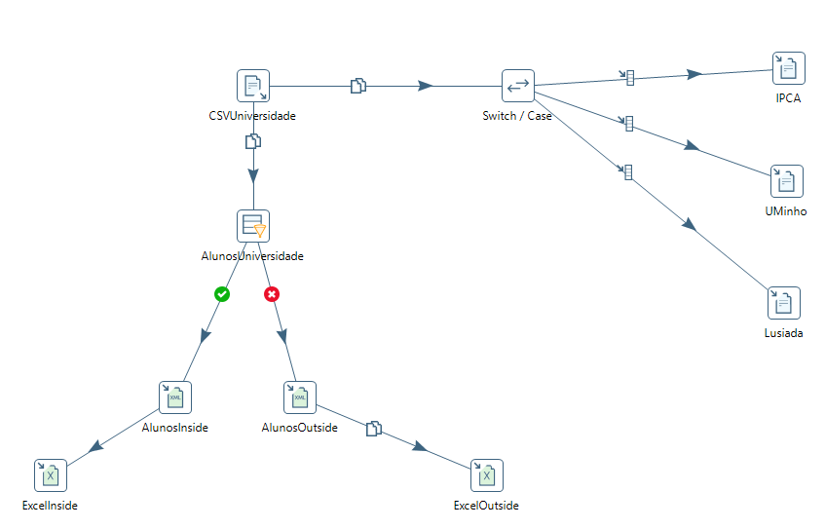
ISI
ETL with Kettle
    Caso de Estudo (II):

Slide 13
ISI
References
  PDI Transformation Tutorial
  PDI Job Tutorial
  Pentaho Data Integration Steps
  https://etl-tools.info/pentaho-tutorial.html
  https://pentaho-community.atlassian.net/wiki/spaces/EAIes/overview
  Outras Plataformas
    https://www.talend.com/products/data-integration
    https://www.knime.com/downloads

